Slide 1
DHCP 原理及其工作过程

Slide 2
DHCP
产生背景
工作原理
典型应用

Slide 3
DHCP产生背景
BOOTP Bootstrap Protocol
配置bootp参数，需要主机位置相对固定，不能随便移动。组网简单
DHCP IETF
主机经常移动 计算机数量超过可分配ip 提高利用率
internet engineering task force 网络工程任务组
优点：动态获得地址 网络环境复杂 规模比较大

Slide 4
DHCP
产生背景
工作原理
典型应用

Slide 5
DHCP八种报文
报文类型 | 主要功能
DHCP-DISCOVER | DHCP客户端广播发送的，用来查找网络中可用的DHCP服务器
DHCP-OFFER | DHCP服务器用来响应客户端的DHCP-DISCOVER请求，并为客户端指定相应配置参数
DHCP-REQUEST | DHCP客户端广播发送给DHCP服务器，用来请求配置参数或者续借租期
DHCP-ACK | DHCP服务器通知客户端可以使用分配的IP地址和配置参数
DHCP-NAK | DHCP服务器通知客户端地址请求不正确或者租期已过期 续租失败
DHCP-RELEASE | DHCP客户端主动向DHCP服务器发送，告知服务器该客户端不再需要分配的IP地址
DHCP-DECLINE | DHCP客户端发现地址冲突或由于其它原因导致地址不能使用，则发送DHCP-DECLINE报文，通知服务器所分配的IP地址不可用
DHCP-INFORM | DHCP客户端已经有IP地址，用它来向服务器请求其他的配置参数
Notes:
(1)发现阶段，即DHCP客户机寻找DHCP服务器的阶段。因为DHCP服务器的IP地址对于客户机来说是未知的，所以DHCP客户机以广播方式发送DHCP-DISCOVER信息来寻找DHCP服务器，即向地址255.255.255.255发送特定的广播信息。网络上每一台安装了TCP/IP协议的主机都会接收到这种广播信息，但只有DHCP服务器才会做出响应。
(2)提供阶段，即DHCP服务器提供IP地址的阶段。在网络中接收到DHCP-DISCOVER信息的DHCP服务器都会做出响应，它从尚未出租的IP地址中挑选一个分配给DHCP客户机，（先发送个arp 报文探测一下看这个报文是否有人在使用）向DHCP客户机发送一个包含出租的IP地址和其他设置的DHCP-OFFER信息。
(3)选择阶段，即DHCP客户机选择某台DHCP服务器提供的IP地址的阶段。如果有多台DHCP服务器向DHCP客户机发来DHCP-OFFER信息，则DHCP客户机只接收第一个收到的DHCP-OFFER信息，然后它就以广播方式回答一个DHCP-REQUEST信息，该信息中包含向它所选定的DHCP服务器请求IP地址的内容。之所以要以广播方式回答，是为了通知所有的DHCP服务器，他将选择某台DHCP服务器所提供的IP地址。 会发送免费arp，探测是否有人在使用自己用的ip地址。
(4)确认阶段，即DHCP服务器确认所提供的IP地址的阶段。当DHCP服务器收到DHCP客户机回答的DHCP-REQUEST信息之后，它便向DHCP客户机发送一个包含它所提供的IP地址和其他设置的DHCP-ACK信息，告诉DHCP客户机可以使用它所提供的IP地址。然后DHCP客户机便将获取到的IP地址与网卡绑定，另外，除DHCP客户机选中的服务器外，其他的DHCP服务器都将收回曾提供的IP地址.

Slide 6
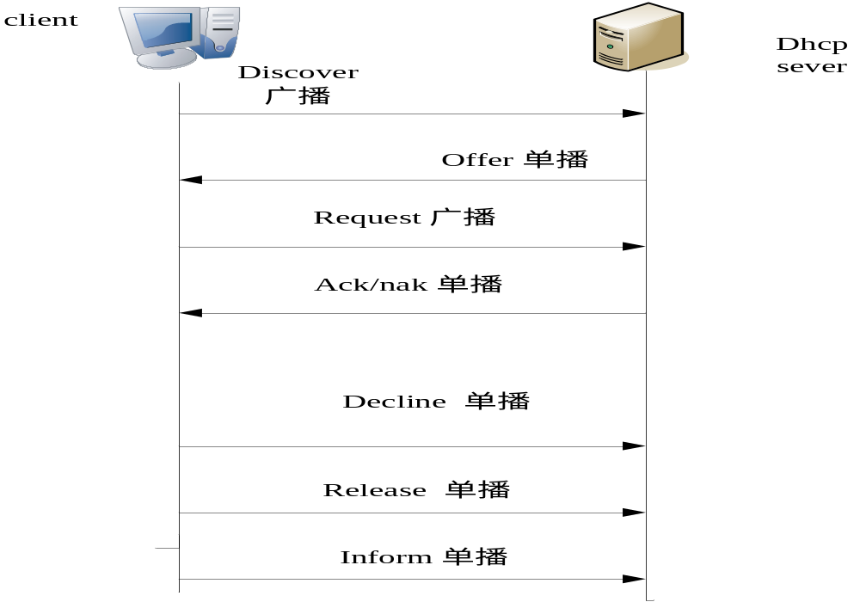
DHCP工作过程
Notes:
(1) 发现阶段，即DHCP客户机寻找DHCP服务器的阶段。因为DHCP服务器的IP地址对于客户机来说是未知的，所以DHCP客户机以广播方式发送DHCP-DISCOVER信息来寻找DHCP服务器，即向地址255.255.255.255发送特定的广播信息。网络上每一台安装了TCP/IP协议的主机都会接收到这种广播信息，但只有DHCP服务器才会做出响应。
(2) 提供阶段，即DHCP服务器提供IP地址的阶段。在网络中接收到DHCP-DISCOVER信息的DHCP服务器都会做出响应，它从尚未出租的IP地址中挑选一个分配给DHCP客户机，（先发送个arp 报文探测一下看这个报文是否有人在使用）向DHCP客户机发送一个包含出租的IP地址和其他设置的DHCP-OFFER信息。
(3) 选择阶段，即DHCP客户机选择某台DHCP服务器提供的IP地址的阶段。如果有多台DHCP服务器向DHCP客户机发来DHCP-OFFER信息，则DHCP客户机只接收第一个收到的DHCP-OFFER信息，然后它就以广播方式回答一个DHCP-REQUEST信息，该信息中包含向它所选定的DHCP服务器请求IP地址的内容。之所以要以广播方式回答，是为了通知所有的DHCP服务器，他将选择某台DHCP服务器所提供的IP地址。 会发送免费arp，探测是否有人在使用自己用的ip地址。。
(4) 确认阶段，即DHCP服务器确认所提供的IP地址的阶段。当DHCP服务器收到DHCP客户机回答的DHCP-REQUEST信息之后，它便向DHCP客户机发送一个包含它所提供的IP地址和其他设置的DHCP-ACK信息，告诉DHCP客户机可以使用它所提供的IP地址。然后DHCP客户机便将获取到的IP地址与网卡绑定，另外，除DHCP客户机选中的服务器外，其他的DHCP服务器都将收回曾提供的IP地址。

Slide 7
DHCP 工作过程
问题:dhcp的 offer 报文中已经填充了server 分配给 client的ip地址。为什么client 还会再发一个 request 报文 ？

Slide 8
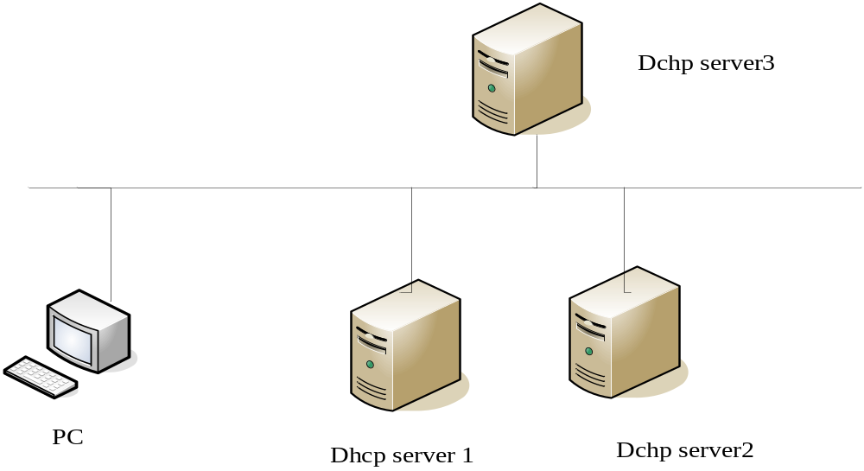
Dhcp 工作过程

Slide 9
Dhcp relay 背景
早期的DHCP 协议只适用于DHCP 客户端和服务器处于同一个子网内的情况，不能跨网段。因此，为进行动态主机配置，需要在所有网段上都设置一个DHCP 服务器，这显然是很不经济的。
DHCP Relay的引入解决了这一难题：局域网内的客户端可以通过DHCP Relay与其他子网的DHCP服务器通信，最终取得合法的IP地址。

Slide 10
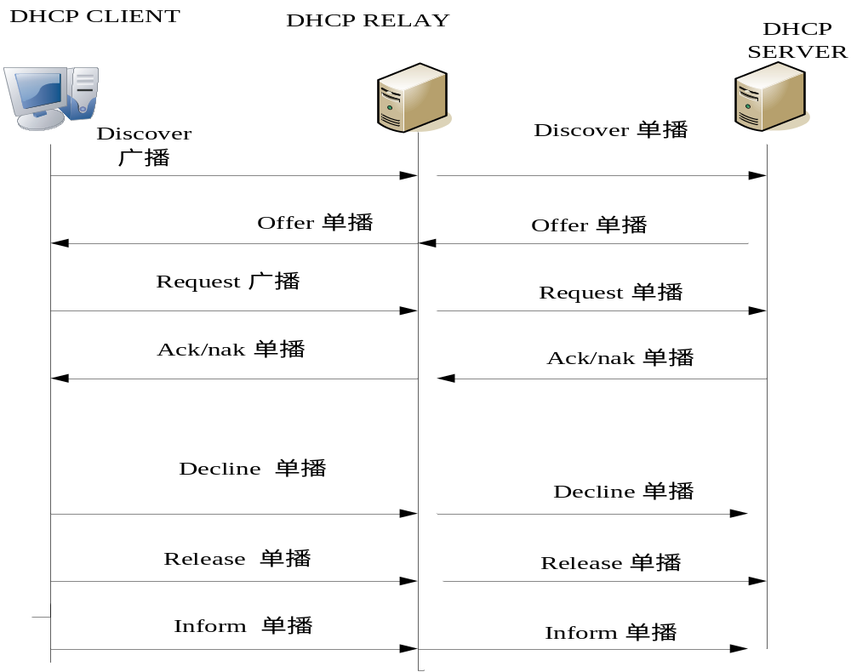
DHCP RELAY

Slide 11
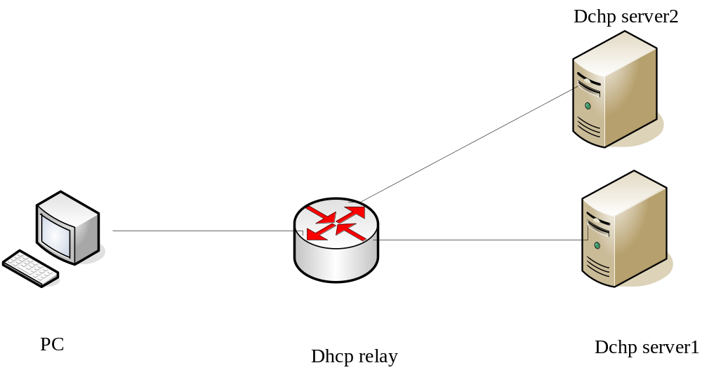
DHCP RELAY 主备

Slide 12
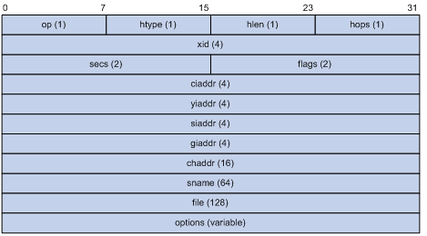
Dhcp的报文格式
Notes:
op：DHCP报文的操作类型，分为请求报文和响应报文，1为请求报文；2为响应报文。
htype、hlen：DHCP客户端的硬件地址类型及长度。
hops：DHCP报文经过的DHCP中继的数目。DHCP请求报文每经过一个DHCP中继，该字段就会增加1。
xid：客户端发起一次请求时选择的随机数，用来标识一次地址请求过程。
secs：DHCP客户端开始DHCP请求后的时间。
flags：第一个比特为广播响应标识位，用来标识DHCP服务器响应报文是采用单播还是广播发送，0表示采用单播方式，1表示采用广播方式。其余比特保留不用。
ciaddr：DHCP客户端的IP地址。
yiaddr：DHCP服务器分配给客户端的IP地址。
siaddr：DHCP客户端获取IP地址等信息的服务器IP地址。
giaddr：DHCP客户端发出请求报文后经过的第一个DHCP中继的IP地址。
chaddr：DHCP客户端的硬件地址。
sname：DHCP客户端获取IP地址等信息的服务器名称。
file：DHCP服务器为DHCP客户端指定的启动配置文件名称及路径信息。
options：可选变长选项字段，包含报文的类型、有效租期、DNS（Domain Name System，域名系统）服务器的IP地址、WINS（Windows Internet Naming Service，Windows Internet名称服务）服务器的IP地址等配置信息。

Slide 13
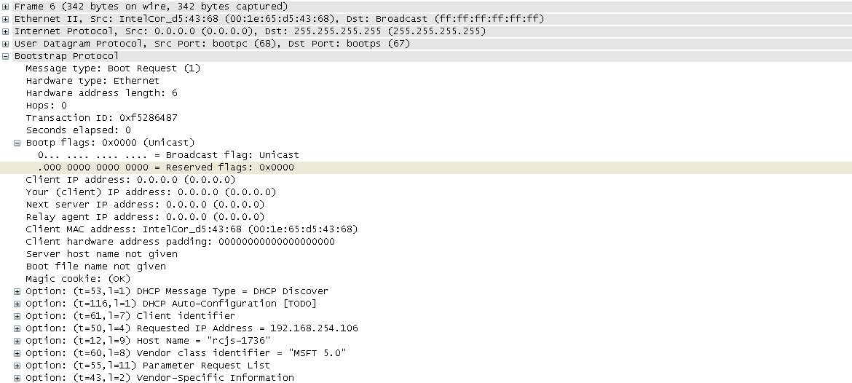
DHCP dicover 报文

Slide 14
Option 选项
Option53 DHCP Message Type
Code Len Type
+-----+-----+-----+
| 53 | 1 | 1-9 |
+-----+-----+-----+
n=1 1 个字节
1 DHCPDISCOVER
2 DHCPOFFER
3 DHCPREQUEST
4 DHCPDECLINE
5 DHCPACK
6 DHCPNAK
7 DHCPRELEASE
8 DHCPINFORM
Notes:
This option is used to convey the type of the DHCP message. The code
for this option is 53, and its length is 1. Legal values for this
option are:
Value Message Type
----- ------------
1 DHCPDISCOVER
2 DHCPOFFER
3 DHCPREQUEST
4 DHCPDECLINE
5 DHCPACK
6 DHCPNAK
7 DHCPRELEASE
8 DHCPINFORM
Code Len Type
+-----+-----+-----+
| 53 | 1 | 1-9 |
+-----+-----+-----+

Slide 15
Opinton 选项
61 client identifier
Code Len Type Client-Identifier
+-----+-----+-----+-----+-----+---
| 61 | n | t1 | i1 | i2 | ...
+-----+-----+-----+-----+-----+---
3d 07 01 00 1e 65 d5 43 68
3D=61
07:7个字节 n 的最小长度为2
01：ethernet
00 1e 65 d5 43 68: 客户端的mac地址
This option is used by DHCP clients to specify their uniqueidentifier
Notes:
This option is used by DHCP clients to specify their unique
identifier. DHCP servers use this value to index their database of
address bindings. This value is expected to be unique for all
clients in an administrative domain.
Identifiers SHOULD be treated as opaque objects by DHCP servers.
The client identifier MAY consist of type-value pairs similar to the
'htype'/'chaddr' fields defined in [3]. For instance, it MAY consist
of a hardware type and hardware address. In this case the type field
SHOULD be one of the ARP hardware types defined in STD2 [22]. A
hardware type of 0 (zero) should be used when the value field
contains an identifier other than a hardware address (e.g. a fully
qualified domain name).
For correct identification of clients, each client's client-
identifier MUST be unique among the client-identifiers used on the
subnet to which the client is attached. Vendors and system
administrators are responsible for choosing client-identifiers that
meet this requirement for uniqueness.
The code for this option is 61, and its minimum length is 2.
Code Len Type Client-Identifier
+-----+-----+-----+-----+-----+---
| 61 | n | t1 | i1 | i2 | ...
+-----+-----+-----+-----+-----+---

Slide 16
Option选项
50 requested ip address
Code Len Address
+-----+-----+-----+-----+-----+-----+
| 50 | 4 | a1 | a2 | a3 | a4 |
+-----+-----+-----+-----+-----+-----+
请求获得曾经获得的ip地址
32＝50
4：4个字节 固定长度
c0 a8 fe 6a=192.168.254.106
Notes:
This option is used in a client request (DHCPDISCOVER) to allow the
client to request that a particular IP address be assigned.
The code for this option is 50, and its length is 4.
Code Len Address
+-----+-----+-----+-----+-----+-----+
| 50 | 4 | a1 | a2 | a3 | a4 |
+-----+-----+-----+-----+-----+-----+

Slide 17
Option 选项
12 host name option
Code Len Host Name
+-----+-----+-----+-----+-----+-----+-----+-----+--
| 12 | n | h1 | h2 | h3 | h4 | h5 | h6 | ...
+-----+-----+-----+-----+-----+-----+-----+-----+--
0c ＝12
n ：长度自定 ，最小长度为1 09 9 个字节
72 63 6a 73 2d 31 37 33 36 = rcjs -1736
Notes:
This option specifies the name of the client. The name may or may
not be qualified with the local domain name (see section 3.17 for the
preferred way to retrieve the domain name). See RFC 1035 for
character set restrictions.
The code for this option is 12, and its minimum length is 1.
Code Len Host Name
+-----+-----+-----+-----+-----+-----+-----+-----+--
| 12 | n | h1 | h2 | h3 | h4 | h5 | h6 | ...
+-----+-----+-----+-----+-----+-----+-----+-----+--

Slide 18
Option 选项
60 Vendor class identifier
+-----+-----+-----+-----+---
| 60 | n | i1 | i2 | ...
+-----+-----+-----+-----+---
Used by DHCP clients to optionally identify the type and configuration of DHCP client.
dhcp 客户端选择性的识别 客户端的类型和配置
可以携带域的配置信息
3c 08 4d 53 46 54 20 35 2e 30
3c=12 , 08 8个字节 n 的最小长度为1
4d 53 46 54 20 35 2e 30 ＝ MSFT 5.0 默认值
Notes:
This option is used by DHCP clients to optionally identify the vendor
type and configuration of a DHCP client. The information is a string
of n octets, interpreted by servers. Vendors may choose to define
specific vendor class identifiers to convey particular configuration
or other identification information about a client. For example, the
identifier may encode the client's hardware configuration. Servers
not equipped to interpret the class-specific information sent by a
client MUST ignore it (although it may be reported). Servers that
Alexander & Droms Standards Track [Page 29]
RFC 2132 DHCP Options and BOOTP Vendor Extensions March 1997
respond SHOULD only use option 43 to return the vendor-specific
information to the client.
The code for this option is 60, and its minimum length is 1.
Code Len Vendor class Identifier
+-----+-----+-----+-----+---
| 60 | n | i1 | i2 | ...
+-----+-----+-----+-----+---

Slide 19
Option 选项
55 Parameter Request List
Code Len Option Codes
+-----+-----+-----+-----+---
| 55 | n | c1 | c2 | ...
+-----+-----+-----+-----+---
37 0b 01 0f 03 06 2c 2e 2f 1f 21 f9 2b
N 的最小值为1
01＝subnet mask
0f=15= domain name 03=router
06=6=domain name server
2c=44= netbios over tcp/ip name server
2e=46=netbios over tcp/ip node type
2f=47=netbios over tcp/ip scope
1f=31=perform router discover 21=33=static route \
F9=249= private/classless static route(micro soft)
2b=43=vendor-specific information
Used by a DHCP client to request values for specified configuration parameters.
Dhcp 客户端制定需要的配置参数
Notes:
9.8. Parameter Request List
This option is used by a DHCP client to request values for specified
configuration parameters. The list of requested parameters is
specified as n octets, where each octet is a valid DHCP option code
as defined in this document.
The client MAY list the options in order of preference. The DHCP
server is not required to return the options in the requested order,
but MUST try to insert the requested options in the order requested
by the client.
The code for this option is 55. Its minimum length is 1.
Code Len Option Codes
+-----+-----+-----+-----+---
| 55 | n | c1 | c2 | ...
+-----+-----+-----+-----+---

Slide 20
Option 选项
43 Vendor Specific Information
Code Len Vendor-specific information 厂商专有信息
+-----+-----+-----+-----+---
| 43 | n | i1 | i2 | ...
+-----+-----+-----+-----+---
Used by clients and servers to exchange vendor-specific information.
客户端和服务器交换厂家专有信息
n 的最小值为1
2b 02 dc 00
Notes:
8.4. Vendor Specific Information
This option is used by clients and servers to exchange vendor-
specific information. The information is an opaque object of n
octets, presumably interpreted by vendor-specific code on the clients
and servers. The definition of this information is vendor specific.
The vendor is indicated in the vendor class identifier option.
Servers not equipped to interpret the vendor-specific information
sent by a client MUST ignore it (although it may be reported).
Clients which do not receive desired vendor-specific information
SHOULD make an attempt to operate without it, although they may do so
(and announce they are doing so) in a degraded mode.
If a vendor potentially encodes more than one item of information in
this option, then the vendor SHOULD encode the option using
"Encapsulated vendor-specific options" as described below:
The Encapsulated vendor-specific options field SHOULD be encoded as a
sequence of code/length/value fields of identical syntax to the DHCP
options field with the following exceptions:
1) There SHOULD NOT be a "magic cookie" field in the encapsulated
vendor-specific extensions field.
2) Codes other than 0 or 255 MAY be redefined by the vendor within
the encapsulated vendor-specific extensions field, but SHOULD
conform to the tag-length-value syntax defined in section 2.
3) Code 255 (END), if present, signifies the end of the
encapsulated vendor extensions, not the end of the vendor
extensions field. If no code 255 is present, then the end of
the enclosing vendor-specific information field is taken as the
end of the encapsulated vendor-specific extensions field.
The code for this option is 43 and its minimum length is 1.
Code Len Vendor-specific information
+-----+-----+-----+-----+---
| 43 | n | i1 | i2 | ...
+-----+-----+-----+-----+---

Slide 21
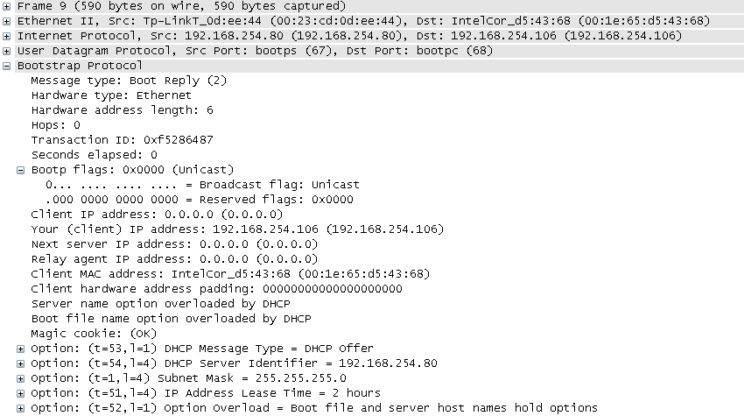
DHCP offer 报文

Slide 22
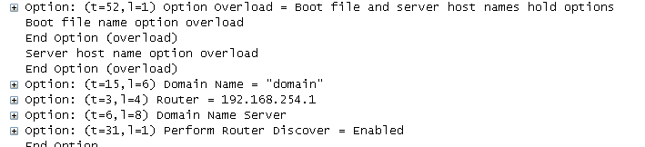
DHCP offer报文

Slide 23
Option 选项 offer 报文
54 dhcp sever identifier
1 subnet mask
Code Len Address
+-----+-----+-----+-----+-----+-----+
| 54 | 4 | a1 | a2 | a3 | a4 |
+-----+-----+-----+-----+-----+-----+
Code Len Subnet Mask
+-----+-----+-----+-----+-----+-----+
| 1 | 4 | m1 | m2 | m3 | m4 |
+-----+-----+-----+-----+-----+-----+
Notes:
9.7. Server Identifier
This option is used in DHCPOFFER and DHCPREQUEST messages, and may
optionally be included in the DHCPACK and DHCPNAK messages. DHCP
servers include this option in the DHCPOFFER in order to allow the
client to distinguish between lease offers. DHCP clients use the
contents of the 'server identifier' field as the destination address
for any DHCP messages unicast to the DHCP server. DHCP clients also
indicate which of several lease offers is being accepted by including
this option in a DHCPREQUEST message.
The identifier is the IP address of the selected server.
The code for this option is 54, and its length is 4.
Alexander & Droms Standards Track [Page 27]
RFC 2132 DHCP Options and BOOTP Vendor Extensions March 1997
Code Len Address
+-----+-----+-----+-----+-----+-----+
| 54 | 4 | a1 | a2 | a3 | a4 |
+-----+-----+-----+-----+-----+-----+

Slide 24
Option 选项 offer 报文
51 ip address lease time
Code Len Lease Time
+-----+-----+-----+-----+-----+-----+
| 51 | 4 | t1 | t2 | t3 | t4 |
+-----+-----+-----+-----+-----+-----+
The time is in units of seconds, and is specified as a 32-bit unsigned integer.
长度固定为4个字节 ，单位是秒
33 04 00 00 1c 20
1c20=7200 S =2 小时
Notes:
9.2. IP Address Lease Time
This option is used in a client request (DHCPDISCOVER or DHCPREQUEST)
to allow the client to request a lease time for the IP address. In a
server reply (DHCPOFFER), a DHCP server uses this option to specify
the lease time it is willing to offer.
Alexander & Droms Standards Track [Page 25]
RFC 2132 DHCP Options and BOOTP Vendor Extensions March 1997
The time is in units of seconds, and is specified as a 32-bit
unsigned integer.
The code for this option is 51, and its length is 4.
Code Len Lease Time
+-----+-----+-----+-----+-----+-----+
| 51 | 4 | t1 | t2 | t3 | t4 |
+-----+-----+-----+-----+-----+-----+

Slide 25
Option 选项 offer 报文
52 option overload
Code Len Value
+-----+-----+-----+
| 52 | 1 |1/2/3|
+-----+-----+-----+
34 01 03
Value Meaning
----- --------
1 the ‘file’ field is used to hold options 文件过载
2 the ‘sname’ field is used to hold options sever 名字过载
3 both fields are used to hold options 文件和server 都过载
This option is used to indicate that the DHCP 'sname' or 'file' fields are being overloaded by using them to carry DHCP options.
用来标识dhcp server name 和file 携带dhcp 选项是否过载
Boot file and sever host name overload option
Notes:
9.3. Option Overload
This option is used to indicate that the DHCP 'sname' or 'file'
fields are being overloaded by using them to carry DHCP options. A
DHCP server inserts this option if the returned parameters will
exceed the usual space allotted for options.
If this option is present, the client interprets the specified
additional fields after it concludes interpretation of the standard
option fields.
The code for this option is 52, and its length is 1. Legal values
for this option are:
Value Meaning
----- --------
1 the 'file' field is used to hold options
2 the 'sname' field is used to hold options
3 both fields are used to hold options
Code Len Value
+-----+-----+-----+
| 52 | 1 |1/2/3|
+-----+-----+-----+

Slide 26
Option 选项 offer 报文
15 domain name
Code Len Domain Name
+-----+-----+-----+-----+-----+-----+--
| 15 | n | d1 | d2 | d3 | d4 | ...
+-----+-----+-----+-----+-----+-----+--
0f 06 64 6f 6d 61 69 6e n 的最小长度为1
64 6f 6d 61 69 6e = "domain"
This option specifies the domain name that client should use when resolving hostnames via the Domain Name System.
用于DNS来区别不同的主机
选项指定域名字 客户端使用他们 当 解决 主机名字 通过 域名服务器
Notes:
3.17. Domain Name
This option specifies the domain name that client should use when
resolving hostnames via the Domain Name System.
The code for this option is 15. Its minimum length is 1.
Code Len Domain Name
+-----+-----+-----+-----+-----+-----+--
| 15 | n | d1 | d2 | d3 | d4 | ...
+-----+-----+-----+-----+-----+-----+--

Slide 27
Option 选项 offer 报文
3 router
Code Len Address 1 Address 2
+-----+-----+-----+-----+-----+-----+-----+-----+--
| 3 | n | a1 | a2 | a3 | a4 | a1 | a2 | ...
+-----+-----+-----+-----+-----+-----+-----+-----+--
03 04 c0 a8 fe 01
C0 a8 fe 01 = 192.168.254.1
The router option specifies a list of IP addresses for routers on the client's subnet.
指定了一系列在客户端同一子网上的ip地址
n 为4 的倍数 一般情况下为 网关
Notes:
3.5. Router Option
The router option specifies a list of IP addresses for routers on the
client's subnet. Routers SHOULD be listed in order of preference.
The code for the router option is 3. The minimum length for the
router option is 4 octets, and the length MUST always be a multiple
of 4.
Code Len Address 1 Address 2
+-----+-----+-----+-----+-----+-----+-----+-----+--
| 3 | n | a1 | a2 | a3 | a4 | a1 | a2 | ...
+-----+-----+-----+-----+-----+-----+-----+-----+--

Slide 28
Option 选项 offer 报文
6 domain name server
Code Len Address 1 Address 2
+-----+-----+-----+-----+-----+-----+-----+-----+--
| 6 | n | a1 | a2 | a3 | a4 | a1 | a2 | ...
+-----+-----+-----+-----+-----+-----+-----+-----+--
06 08 c0 a8 65 01 c0 a8 fe 50
N 的最小长度为4，且为4的倍数
Ip1＝ 192.168.101.1 主用dns
Ip2＝192.168.254.80 备用dns
The domain name server option specifies a list of Domain Name System name servers available to the client.
指定了一个dns的 列表
Notes:
The domain name server option specifies a list of Domain Name System
(STD 13, RFC 1035 [8]) name servers available to the client. Servers
SHOULD be listed in order of preference.
The code for the domain name server option is 6. The minimum length
for this option is 4 octets, and the length MUST always be a multiple
of 4.
Code Len Address 1 Address 2
+-----+-----+-----+-----+-----+-----+-----+-----+--
| 6 | n | a1 | a2 | a3 | a4 | a1 | a2 | ...
+-----+-----+-----+-----+-----+-----+-----+-----+--

Slide 29
Option选项 offer报文
31 peform router discovery option
Code Len Value
+-----+-----+-----+
| 31 | 1 | 0/1 |
+-----+-----+-----+
1f 01 01
0: client should not perform router discovery. 客户端不执行路由器发现
1: client should perform router discovery. 执行路由器发现
This option specifies whether or not the client should solicit
routers using the Router Discovery mechanism defined in RFC 1256
指定 客户端是否请求路由器发现
Notes:
This option specifies whether or not the client should solicit
routers using the Router Discovery mechanism defined in RFC 1256
[13]. A value of 0 indicates that the client should not perform
router discovery. A value of 1 means that the client should perform
router discovery.
The code for this option is 31, and its length is 1.
Code Len Value
+-----+-----+-----+
| 31 | 1 | 0/1 |
+-----+-----+-----+

Slide 30
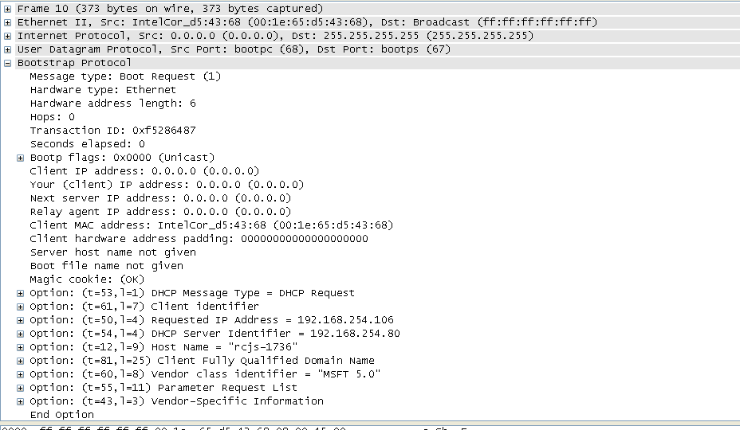
DHCP request 报文

Slide 31
Oition选项 request报文
12 host name option
Code Len Host Name
+-----+-----+-----+-----+-----+-----+-----+-----+--
| 12 | n | h1 | h2 | h3 | h4 | h5 | h6 | ...
+-----+-----+-----+-----+-----+-----+-----+-----+--
0c 09 72 63 6a 73 2d 31 37 33 36 ＝ “rcjs-1736” 最小长度是 1

Slide 32
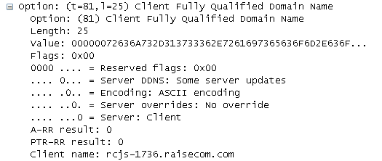
Dhcp 选项 request 报文

Slide 33
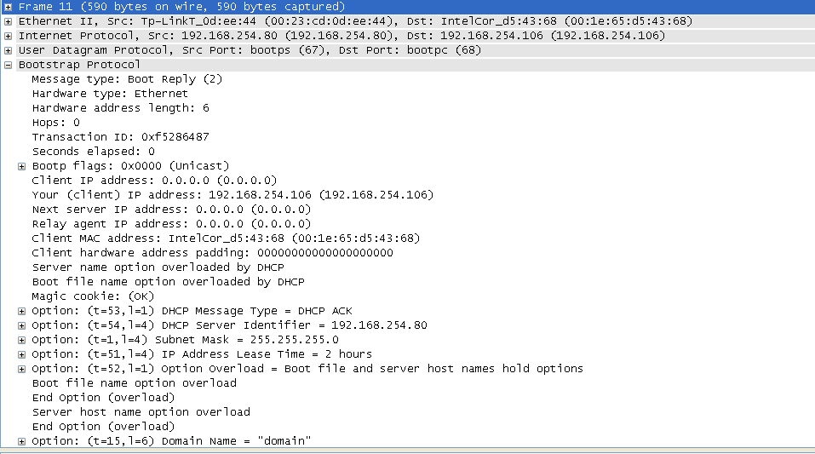
DHCP ack 报文

Slide 34
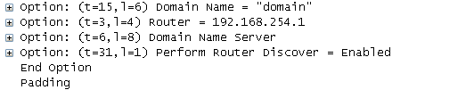
DHCP ack 报文

Slide 35
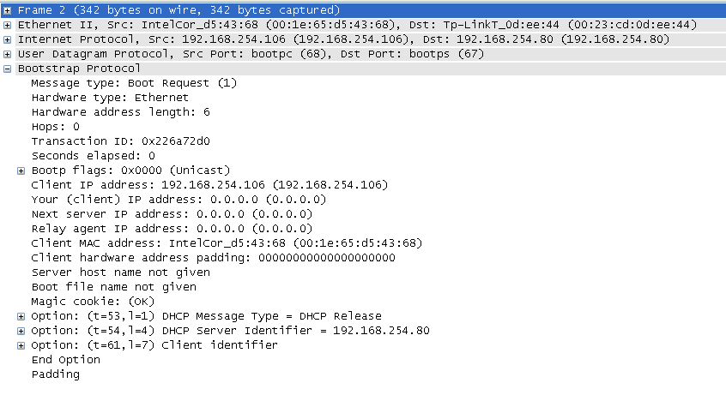
Dhcp release 报文

Slide 36
Dhcp 常用option选项
option1 subnet mask
option3 router
option6 domain name server
option12 host name option
option50 requested ip address
option51 ip address lease time
option53 dhcp message type
option54 dhcp sever identifier
option60 Vendor class identifier
option61 client identifier (mac)

Slide 37
Dhcp 报文的选项对比
discover
53,116,61,50,12,60,55,43
offer
53,54,1,51,52,15,3,6,31
request
53,61,50,54,12,81,60,55,43
ack
53,54,1,51,52,15,3,6,31

Slide 38
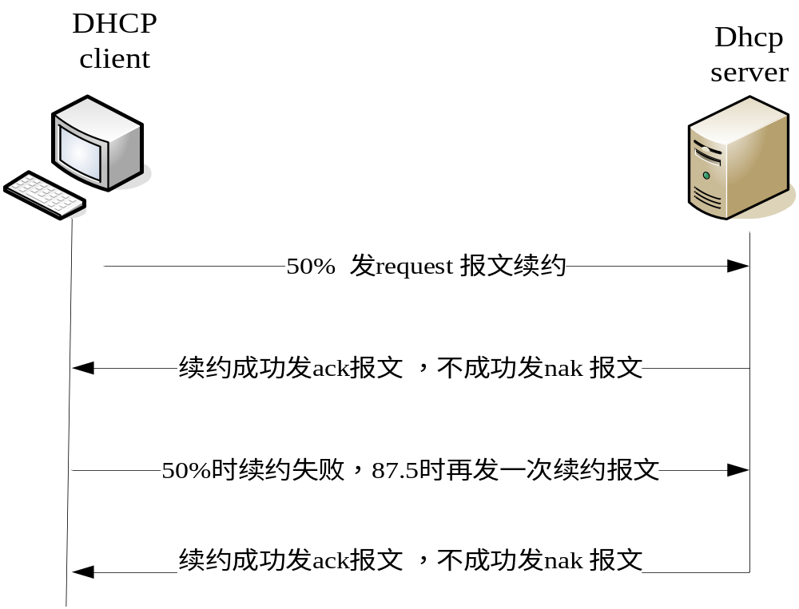
Dhcp 续约

Slide 39
DHCP 客户端重新启动
先发Dhcp request 报文，requested ip address 填原来获得的ip地址
发rquest之后没有获得ip地址，然后发discover 报文，request ip address 选项置0

Slide 40
DHCP
产生背景
工作原理
典型应用

Slide 41
DHCP 相关名词解释
TACAS
Terminal access controller access controller system 终端接入控制系统
DSLAM
digital subscriber line access multiplexer 数字用户线 接入复接器
RADIUS
remote authentication dial in user service 远程认证拨入用户服务器
BRAS
broadband remote access server 宽带远程接入服务器
BAS
Broadband access server
SR
service router
AAA
Authentication,authorization,accounting

Slide 42
DHCP 用户上线认证方式
Option82方式
option82用来区分不同的用户，分配sq资源。
在DSLAM或者是路由器上插入option82
option82的构成：
设备编号（交换机或者dslarm）＋slot＋pic＋port＋vlan
option60：同一用户有多个终端申请ip地址时，通过option60带不同的域名来区分
例如： 机顶盒 带“vedio”
voip终端 带“voip”
不带域名 pc上网

Slide 43
Dhcp 用户上线认证方式
Host方式
通过ip和mac地址对来识别不同的用户，分配sq资源
Qinq方式
根据内层q和p-vlan-group 来分配sq资源
内层Q表示用户，外层q表示业务

Slide 44
Radius 介绍
Radius 是一个认证计费服务的统称。多运行在linux上
包含Freeraidius ,radiator,tacas 等
是一种基于UDP协议的上层协议，认证服务的监听端口号为1812，记费服务的监听端口号为1813

Slide 45
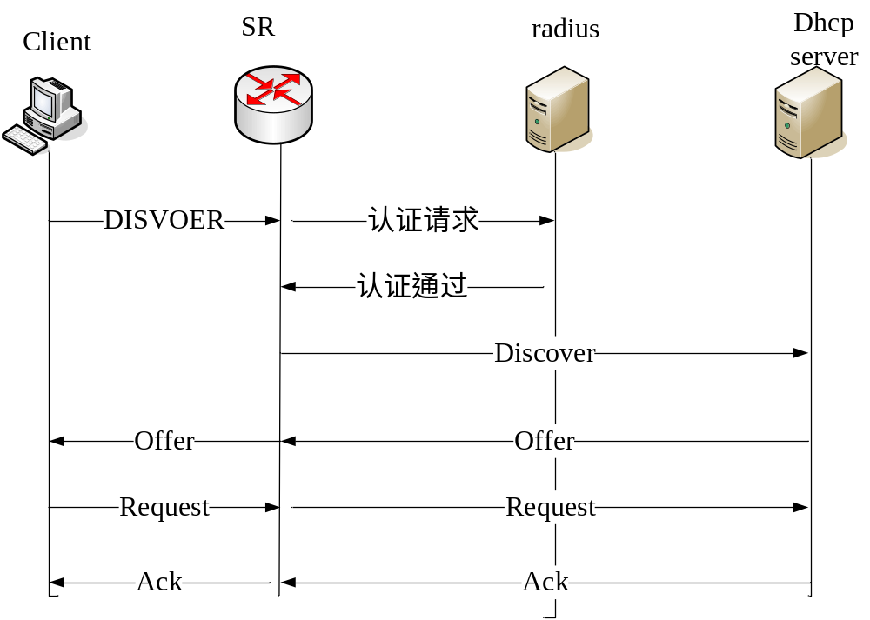
Dhcp redius 认证过程

Slide 46
Portal 介绍
Portal在英语中是入口的意思。Portal认证通常也称为Web认证，一般将Portal认证网站称为门户网站。
未认证用户上网时，设备强制用户登录到特定站点，用户可以免费访问其中的服务。当用户需要使用互联网中的其它信息时，必须在门户网站进行认证，只有认证通过后才可以使用互联网资源。

Slide 47
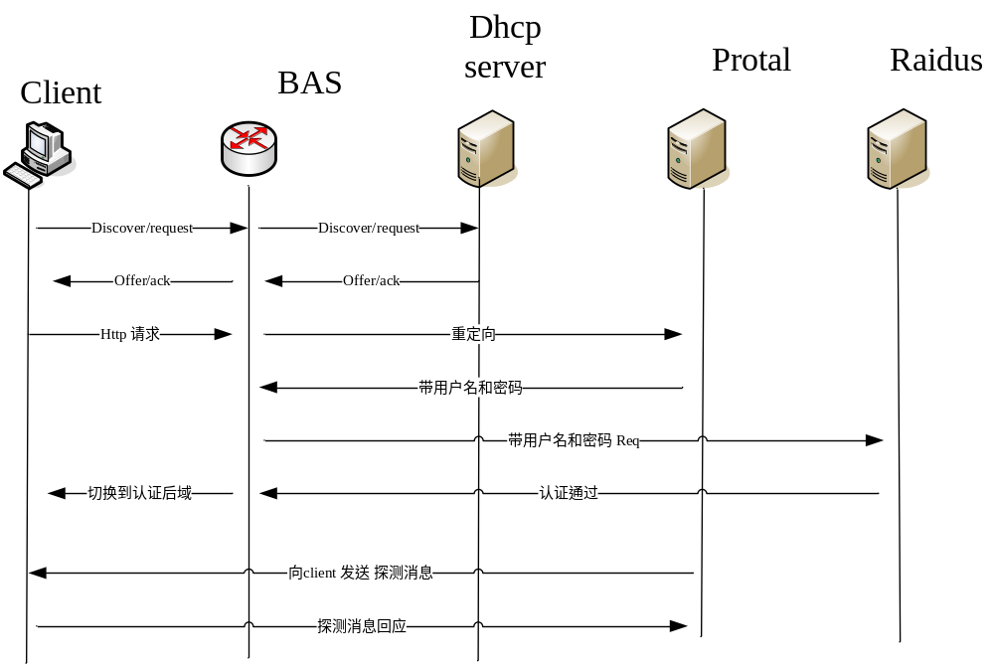
Dhcp portal 过程

Slide 48
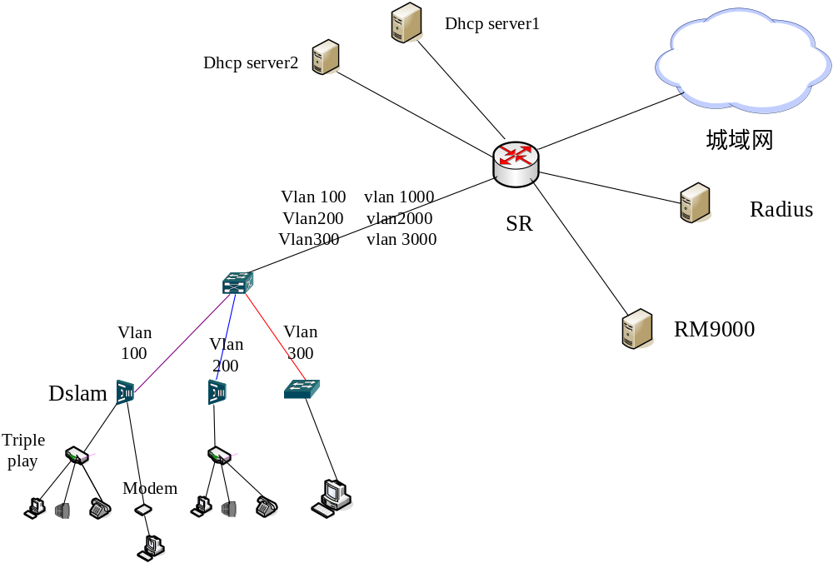
Dhcp

Slide 49
Arp 探测和 idle-cut
Arp 探测
用户在线之后，bas 设备会定期的发送arp 报文，探测用户是否在线
在arp 探测失败之后，会通知相应模块做相应处理
Idle-cut
设定门限值。低于门限值时，对用户做切断处理。有效利用ip地址

Slide 50
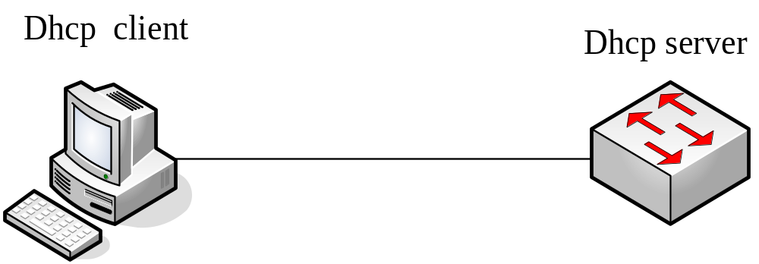
DHCP 单跳直连

Slide 51
Dhcp 单跳基本配置
创建vlan和接口
ISCOM3026E(config)#create vlan 100 active
ISCOM3026E(config)#int p 1
ISCOM3026E(config-port)#switchport access vlan 100
ISCOM3026E(config)#int ip 1
ISCOM3026E(config-ip)#ip a 192.168.100.1 100
ISCOM3026E(config)#
创建地址池
IISCOM3026E (config)#ip dhcp server ip-pool aaa 192.168.100.2 192.168.100.254 255.255.255.0 ip 1 gateway 192.168.100.1
启动dhcp server
ISCOM3026E(config)#ip dhcp server
ISCOM3026E(config)#int p 1
ISCOM3026E(config-ip)#ip dhcp server
ip 接口下的dhcp server 必须启动,默认是不启动的

Slide 52
Dhcp server 查看命令
show ip dhcp server
DHCP Server: Enabled
IP Interface Enabled: 1
Total Number: 1
Option 82: Enabled
Max lease time: 10080 m
Min lease time: 30 m
Default lease time: 30 m
Statistics information:
Running time: 0 hours 0 minutes 54 seconds
Bootps: 0
Discover: 0
Request: 0
Release: 0
Offer: 0
Ack: 0
Nack: 0
Decline: 0
Information: 0
Unknows: 0
Total: 0

Slide 53
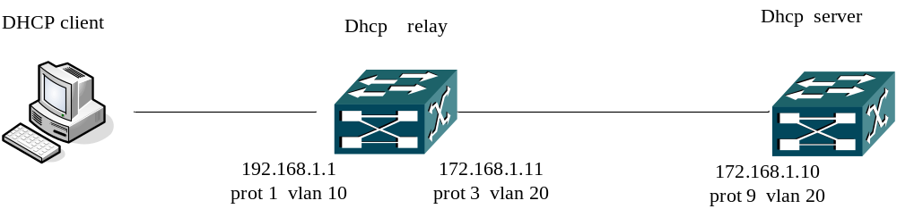
Dhcp relay

Slide 54
Dhcp relay 配置
配置 dhcp relay
1.创建vlan 和ip 接口
ISCOM3026E(config)#create vlan 10,20 active
ISCOM3026E(config-port)#int port 1
ISCOM3026E(config-port)#switchport access vlan 10
ISCOM3026E(config-port)#int port 3
ISCOM3026E(config-port)#switchport access vlan 20
ISCOM3026E(config)#int ip 2
ISCOM3026E(config-ip)#ip address 172.168.1.11 255.255.255.0 20
ISCOM3026E(config)#int ip 5
ISCOM3026E(config-ip)ip address 192.168.1.1 255.255.255.0 10
2.启动dhcp relay 功能
ISCOM3026E(config)#ip dhcp relay
ip 接口下的dhcp relay 默认是开启的

Slide 55
Dhcp relay 配置
3.配置dhcp server的ip地址
ISCOM3026E(config)#ip dhcp relay ip-list 5 target-ip 172.168.1.10
4.启动路由功能
ISCOM3012GF(config)#ip routing
配置dhcp server
1.创建vlan 和接口
ISCOM3012GF(config)#create vlan 20 active
ISCOM3012GF(config-port)#int port 9
ISCOM3012GF(config-port)#switchport access vlan 20
ISCOM3012GF(config)#int ip 1
ISCOM3012GF(config-ip)#ip address 172.168.1.10 255.255.255.0 20
2. 启动dhcp server
ISCOM3012GF(config)#ip dhcp server
ISCOM3012GF(config-ip)#int ip 1
ISCOM3012GF(config-ip)#ip dhcp server 接口下默认是不开启的,所以要开启

Slide 56
Dhcp relay 配置
3.配置dhcp 地址池
ISCOM3012GF(config)#ip dhcp server ip-pool aaa 192.168.1.100 192.168.1.200 255.255.255.0 ip 1 gateway 192.168.1.1
4.制定对端relay的 地址
ISCOM3012GF(config)#ip dhcp server relay-ip 192.168.1.1 255.255.255.0
5.配置到对端的默认路由
ISCOM3012GF(config)#ip route 192.168.1.0 255.255.255.0 172.168.1.11
6.启动路由功能
ISCOM3012GF(config)#ip routing

